Slide 1

Interest Rates and their predictive Power on the Stock market
by Aaron Gresser

Slide 2
Agenda
A brief Introduction
Research Questions
Dataset Overview
Approach and Methods
Outlook
Intro
Notes:
https://www.reddit.com/r/Forex/comments/c3wjo1/gold_dinosaur_sell_pattern/#lightbox

Slide 3
The Stock Market – An Introduction
The Basics of Price Building
Efficient Market Hypothesis (EMH)
The Role of Institutional Investors¹
Reserve Banks & Monetary Policy
Notes:
⁽¹https://accountinginsights.org/retail-investors-vs-institutional-investors-percentage-breakdown-explained/#:~:text=Retail%20investors%20are%20individuals%20buying%20stocks%2C%20bonds%2C%20or,of%20influence%20shape%20market%20trends%2C%20liquidity%2C%20and%20volatility.)

Slide 4
Research Questions
Do “Interest Rate Change-Announcements” create predictable Stock Market movements?
Can Sentiment Analysis contribute to a more accurate market prediction?
Does the implementation of more complex models improve the effectiveness of the prediction?

Slide 5
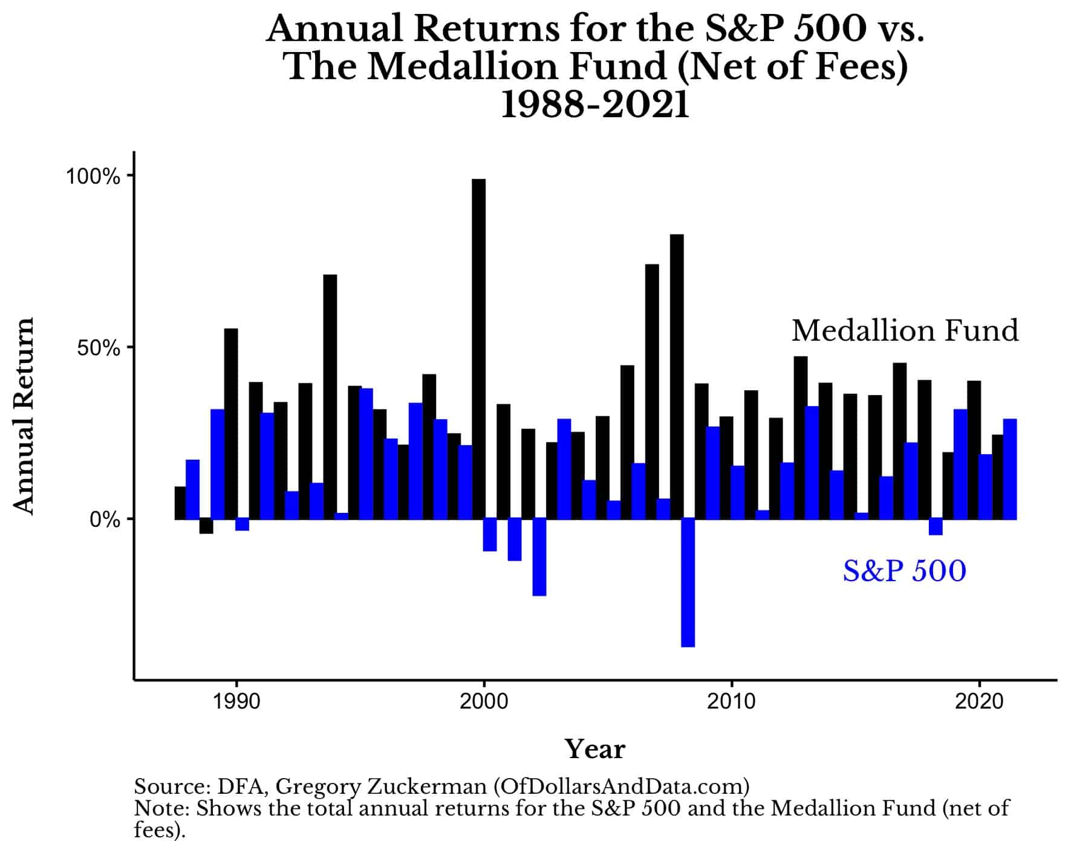
Applications of Data Science
Quantitative Finance
High Frequency Trading
Algorithmic Trading
Momentum Trading
Notes:
https://debeeqpetronille.pages.dev/ncijhd-renaissance-technologies-returns-krvcdwsmr-photos/

Slide 6
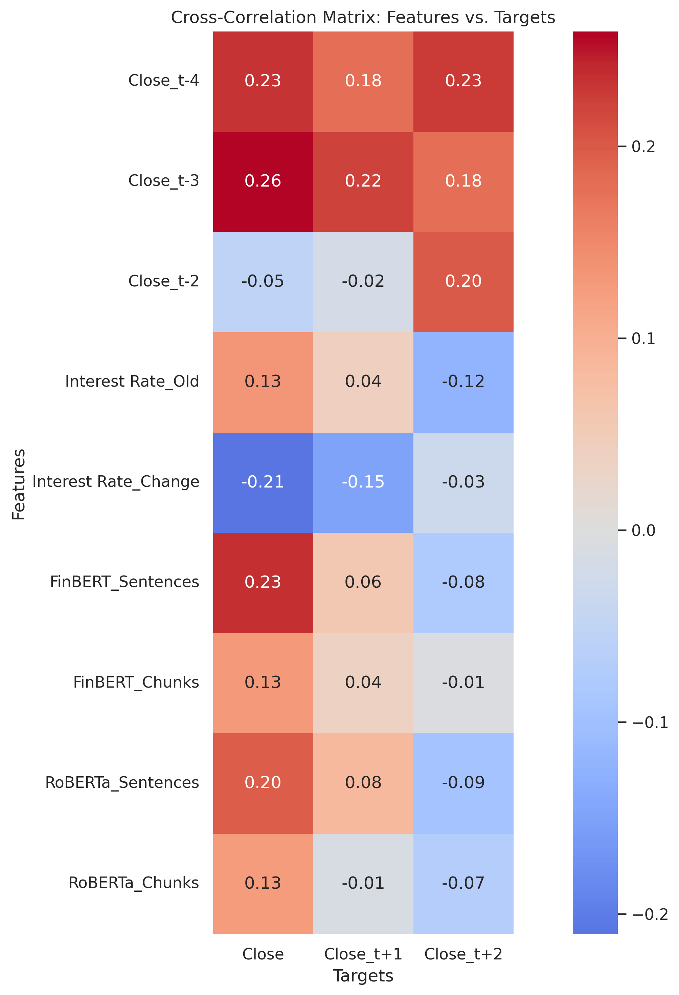
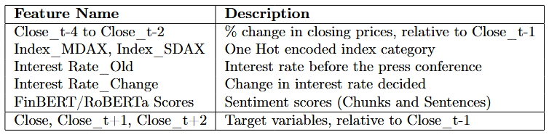
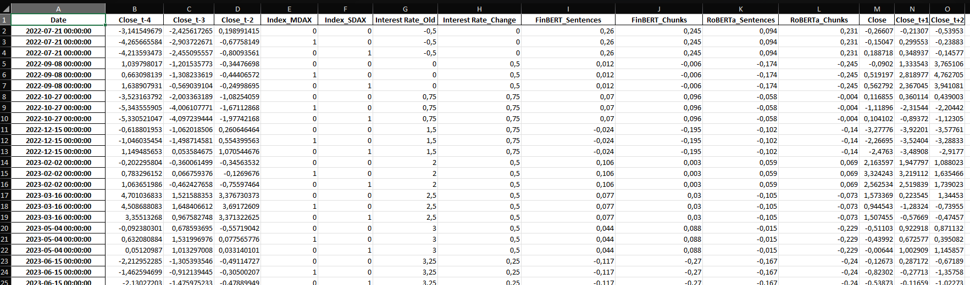
Dataset Overview

Slide 7
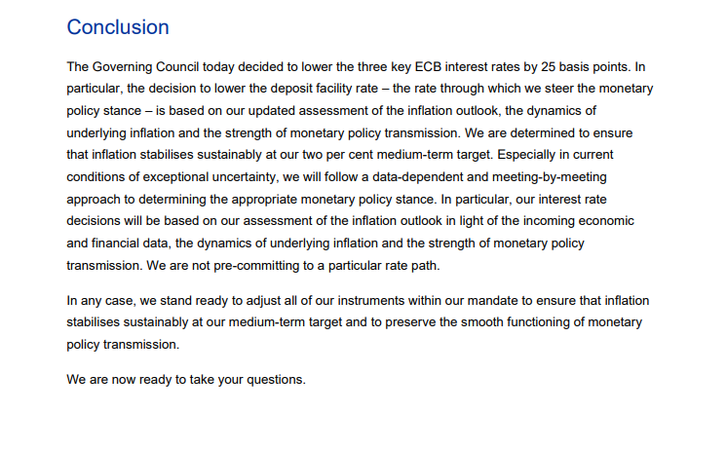
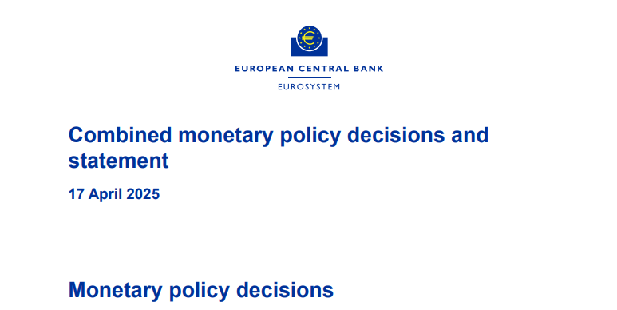
Notes:
https://data.ecb.europa.eu/

Slide 8
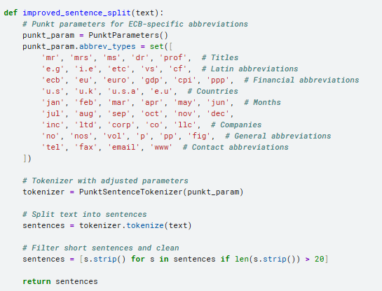
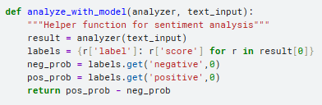
Sentiment Analysis - Pipeline

Slide 9
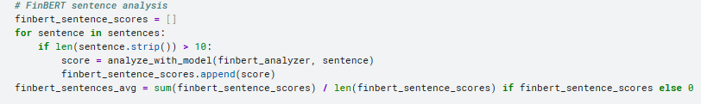
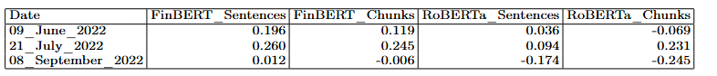
Sentiment Analysis - Results

Slide 10
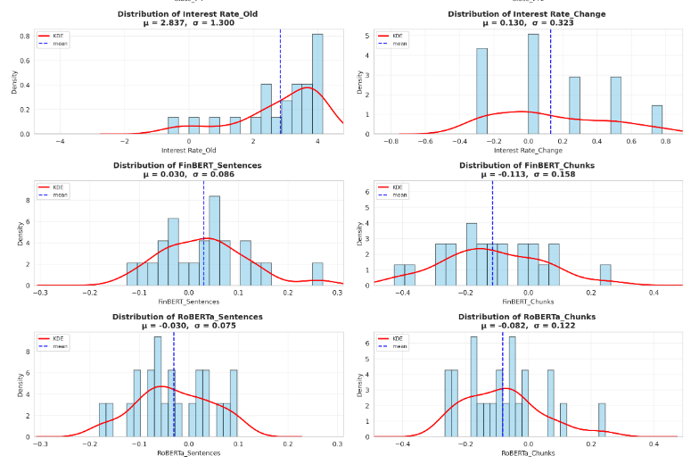
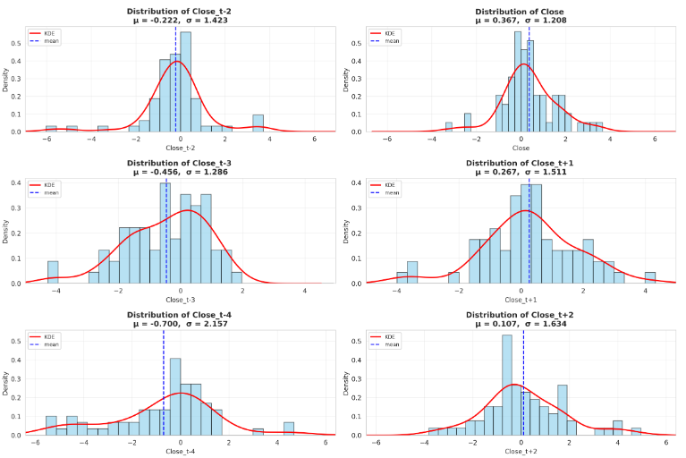

Slide 11
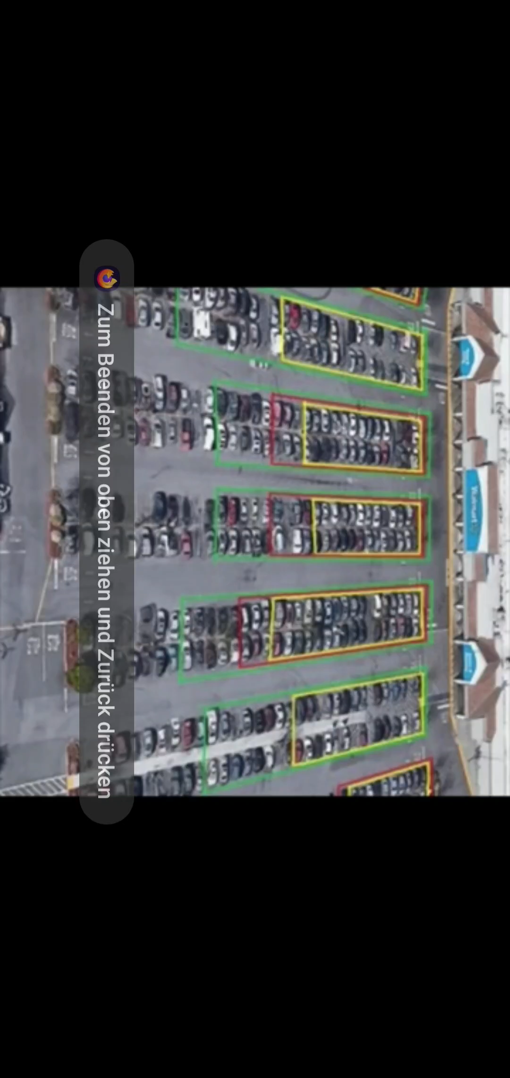
Notes:
Source:https://youtu.be/TQuxVz52w2w?si=7ag-qzwCv776V-9l

Slide 12


My Approach
Predict the Change in the Underlying
Interest rate change
Interest Rate Regime
Press statement
Market Anticipation
Notes:
https://www.bing.com/images/search?view=detailV2&ccid=9ddNQXXH&id=F5B2461AE2A3606D88D191DDE84C184EF6C67099&thid=OIP.9ddNQXXHQKCfsDTgTmP-qAHaFm&mediaurl=https%3A%2F%2Fi.imgflip.com%2F836x0n.png&cdnurl=https%3A%2F%2Fth.bing.com%2Fth%2Fid%2FR.f5d74d4175c740a09fb034e04e63fea8%3Frik%3DmXDG9k4YTOjdkQ%26pid%3DImgRaw%26r%3D0&exph=499&expw=659&q=Pepe+Silvia+Meme+transparent&simid=608033813921953136&form=IRPRST&ck=83B80A5F7ABC04C162C9A319FCC2C3D6&selectedindex=0&itb=1&ajaxhist=0&ajaxserp=0&vt=0&sim=11
https://www.pngwing.com/en/free-png-arnzw/download
https://worldvectorlogo.com/de/logo/openai-wordmark

Slide 13
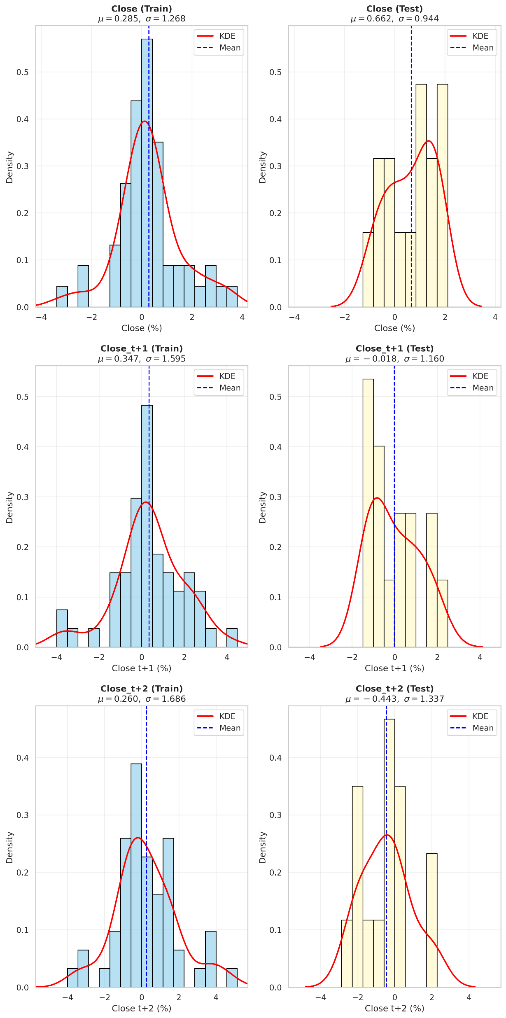
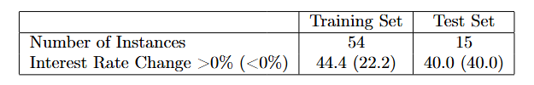
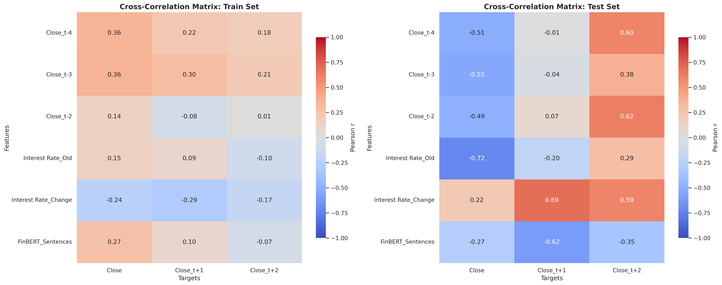
Train/Test set

Slide 14
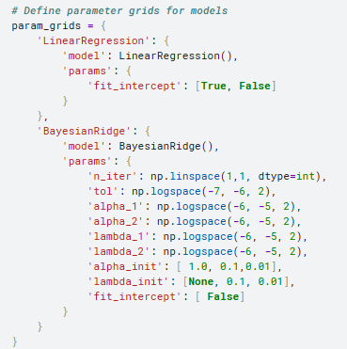
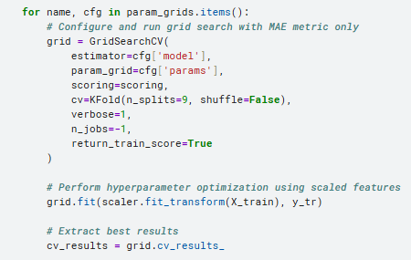
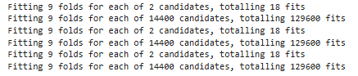
Hyperparamter Configuration

Slide 15
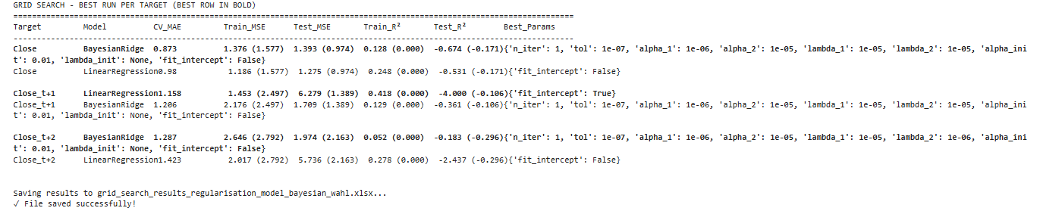
Hyperparameter Results

Slide 16
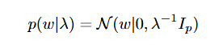
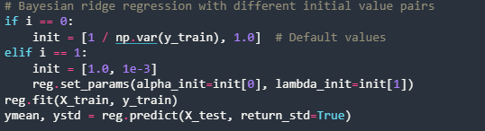
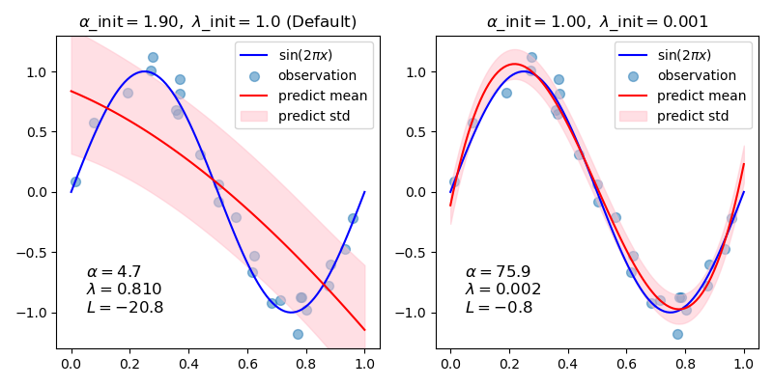
Bayesian Ridge Regression
Notes:
https://scikit-learn.org/stable/auto_examples/linear_model/plot_bayesian_ridge_curvefit.html#sphx-glr-auto-examples-linear-model-plot-bayesian-ridge-curvefit-py

Slide 17
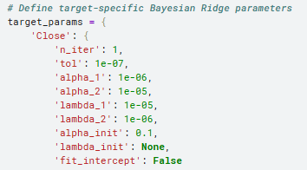
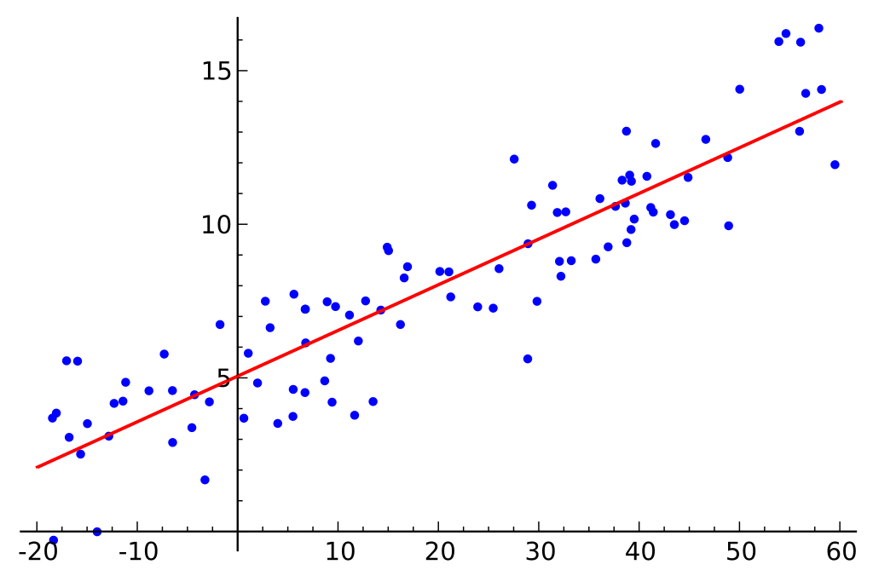
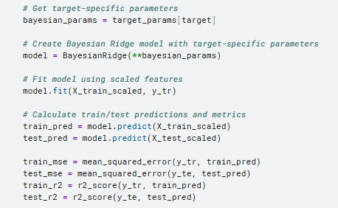
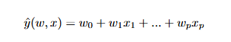
Linear Regression
Notes:
https://en.wikipedia.org/wiki/Linear_regression#/media/File:Linear_regression.svg

Slide 18
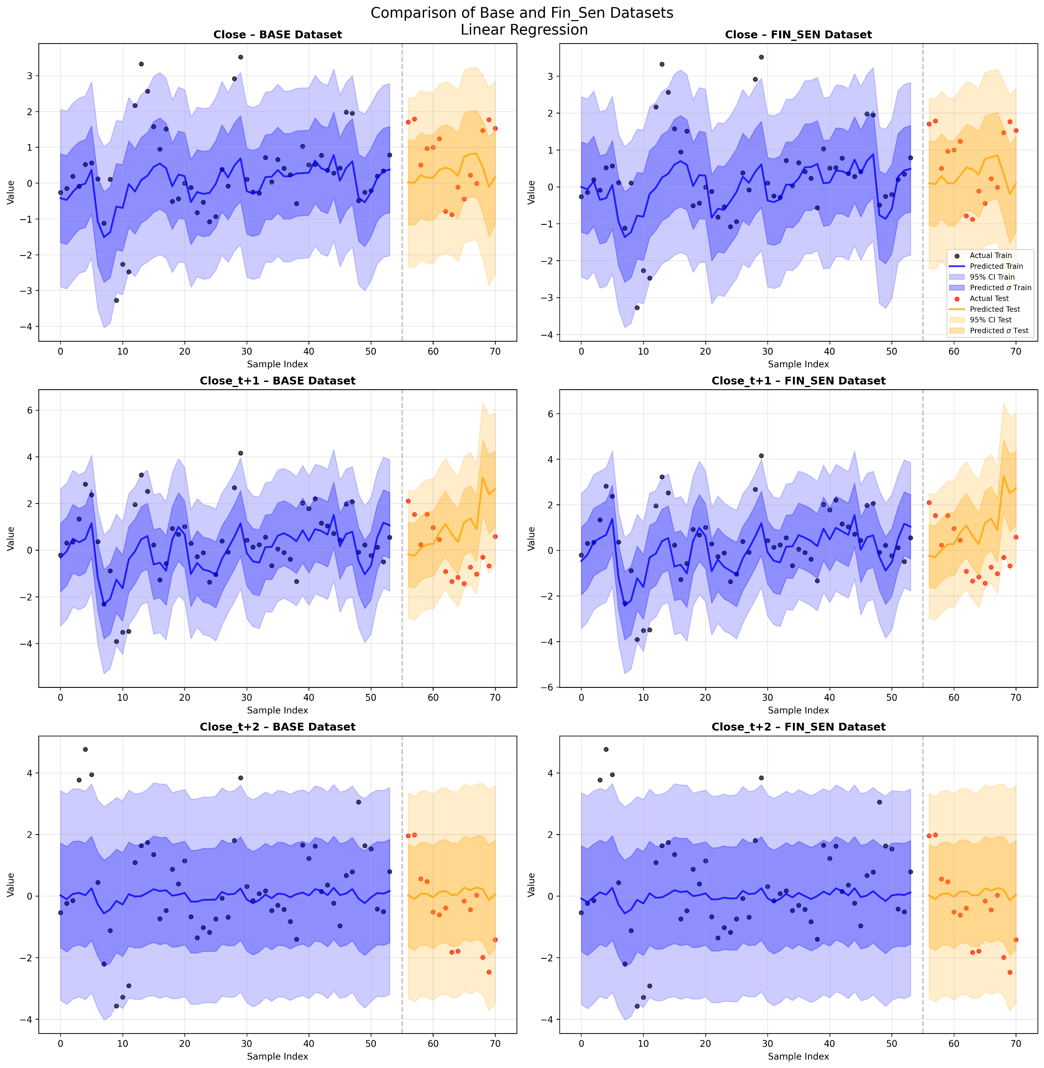
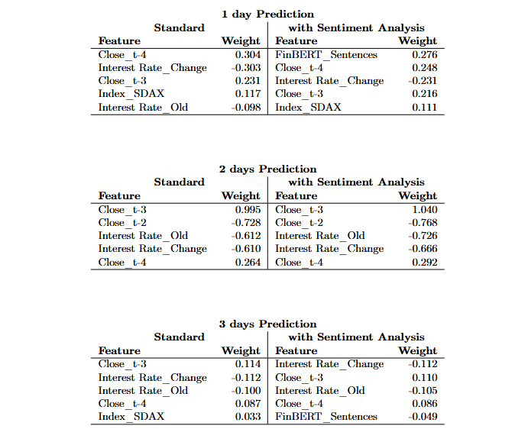

Slide 19
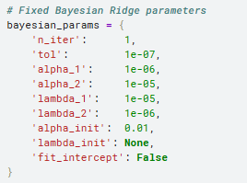
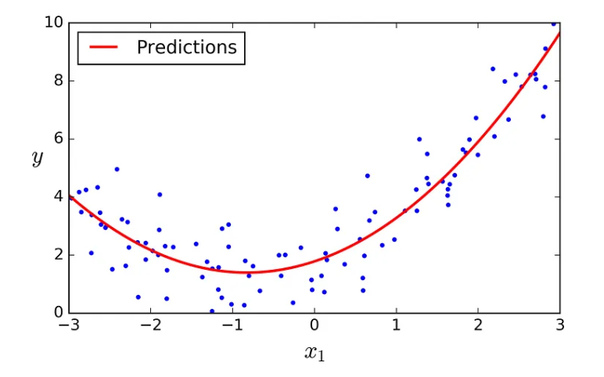
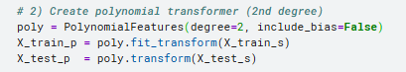
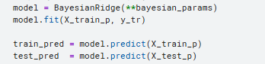
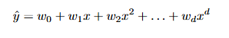
Polynomial Regression
Notes:
https://medium.com/@renadalhendy/build-a-polynomial-regression-model-in-python-using-scikit-learn-1b5fd31beb02

Slide 20
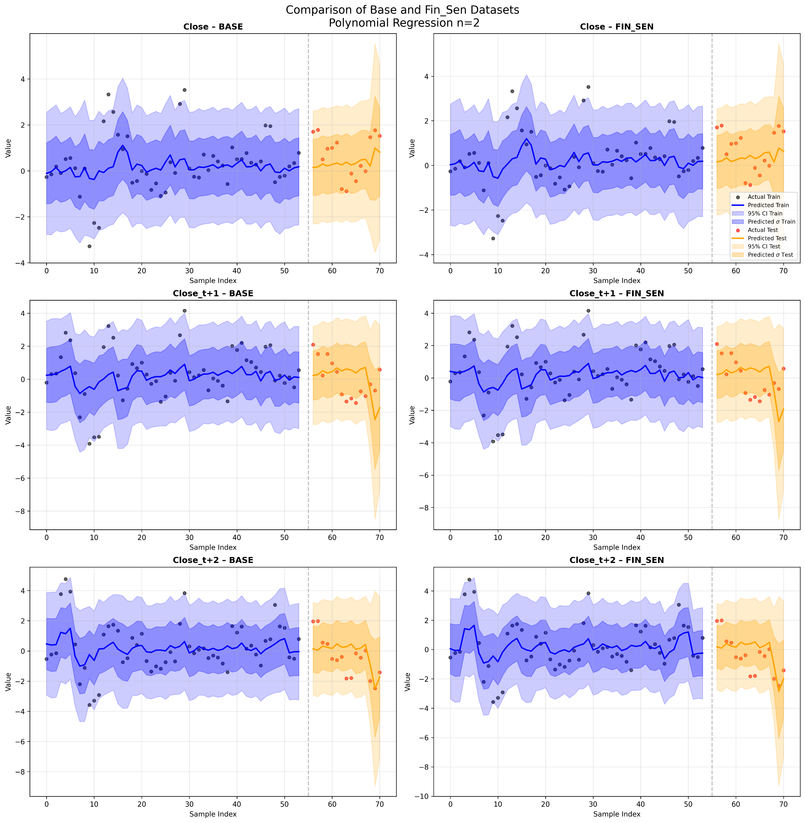
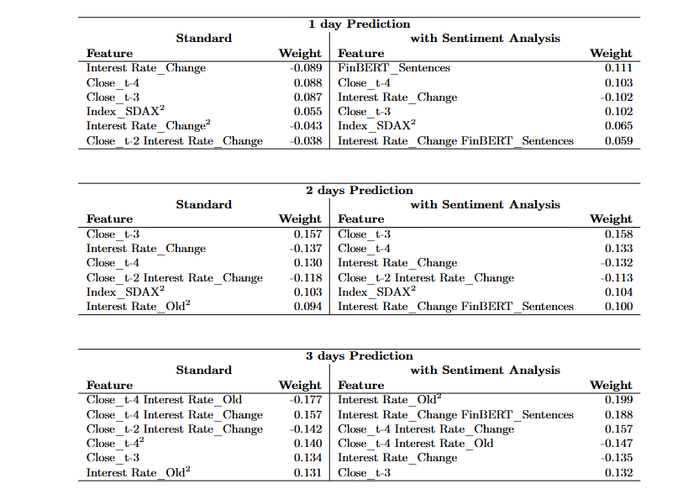

Slide 21
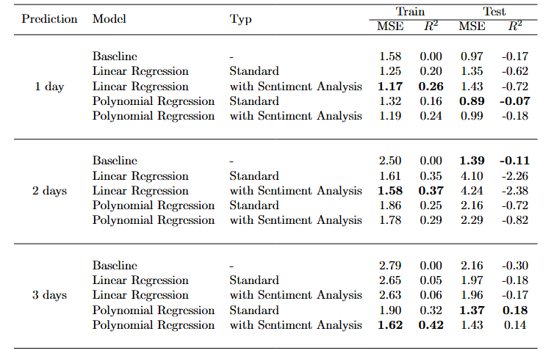
Evaluation

Slide 22
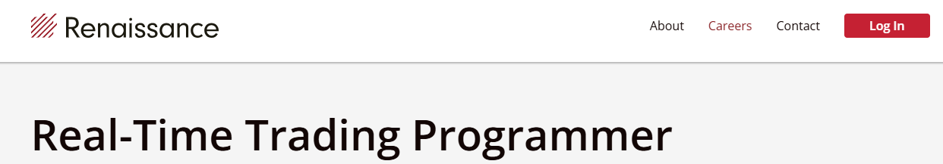
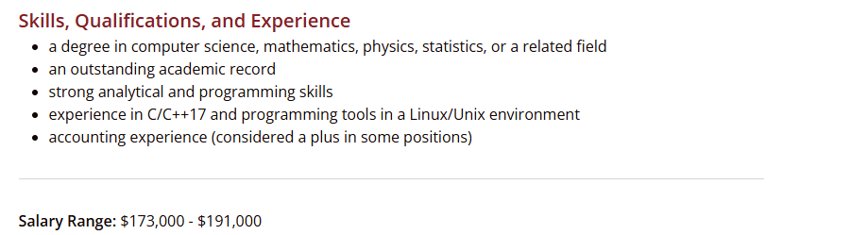
Notes:
https://www.rentec.com/Careers.action?jobs=true&selectedPosition=realtimeTradingProgrammer

Slide 23

This concludes my presentation. Thank you – do you have any questions?
Notes:
https://medium.com/@1otherface/graduation-1cb6b6b43fae

Slide 24
References
https://papers.ssrn.com/sol3/papers.cfm?abstract_id=2941281
https://www.kaggle.com/learn
https://www.ecb.europa.eu/home/html/index.en.html

